Slide 1
Intersection of Big Data, Analytics, and GIS
James Pick and Namchul Shin

Slide 2
Definition of Spatial Big Data
Big Data are “data sets that are so big they cannot be handled efficiently by common database management systems” (Dasgupta, 2013).
Spatial Big Data represents Big Data in the form of spatial layers and attributes.
  There is no standard threshold on minimum size of Big Data or Spatial Big Data, although big data in 2013 was considered one petabyte (1,000 terabytes) or larger (Dasgupta, 2013).

Slide 3
Sources of Spatial Big Data
Sources of Spatial Big Data include:
  GPS, including
  GPS-enabled devices
  Satellite remote sensing
  Aerial surveying
  Radar
  Lidar
  Sensor networks
  Digital cameras
  Location of readings of RFID
(Partially based on Dasgupta, 2013)

Slide 4
Five V’s of Spatial Big Data
Volume
    Satellite imagery covers the globe so is vast.
    Sensors are expanding worldwide at a rapid rate.
    Digital cameras have reached several billion through spatially-reference cell phones.
Variety
    The form of data is based on 2-D or 3-D points configured as vector or raster imagery. This is entirely different than conventional big data which is alphanumeric or pixel-based (similar to raster but not vector)
Velocity
    Velocity is very fast since imagery travels at speed of light.

Slide 5
Five V’s of Spatial Big Data (cont.)
Veracity
    For vector data (points, lines, and polygons), the quality varies). It depends on whether the points have been GPS determined, or determined by unknown origins or manually. Also, resolution and projection issues can alter veracity.
    For geocoded points, there may be errors in the address tables and in the point location algorithms associated with addresses
    For raster data, veracity depends on accuracy of recording instruments in satellites or aerial devices, and on timeliness.

Slide 6
Five V’s of Spatial Big Data
Value
    For real-time spatial big data, decisions can be enhance through visualization of dynamic change in such spatial phenomena as climate, traffic, social-media-based attitudes, and massive inventory locations.
    Exploration of data trends can include spatial proximities and relationships.
    Once spatial big data are structured, formal spatial analytics can be applied, such as spatial autocorrelation, overlays, buffering, spatial cluster techniques, and location quotients.

Slide 7
Spatial Big Data Analytics
Tobler’s first law of geography
  “Everything is related to everything else, but near things are more related than distant things.”
Power of location
  Location targeting improves the performance of mobile advertising, e.g., Foursquare.
Grand challenges, such as sustainability and climate change, health, transnationally organized crime, energy, economic development, etc.
  For example, eco-routing, rather than faster routing

Slide 8
Data-Driven, Real-Time Science
New types of geospatial data generated continuously at a very high speed; Need to look at the incoming data on the fly and make decisions in time (Lee and Kang, 2015).
  Need interactive (real-time) or dynamic analysis on geospatial big data, such as complex event processing and spatial online analytical processing.
Data-intensive hypothesis generation (via spatial statistics, machine learning, spatial data mining, and geo-visual analytics) and A-B testing (Cugler, Oliver, Evans, Shekhar, and Medeiros, 2013).

Slide 9
Data Production
Traditional
Digital Age
Science
Science
Data
Data
Knowledge
Production
Knowledge
Production
Data
Production

Slide 10
Data Practices
Collecting and analyzing
Processing and managing
Assembling and organizing
Preserving and curating
  Generation of meta data
  Provenance information

Slide 11
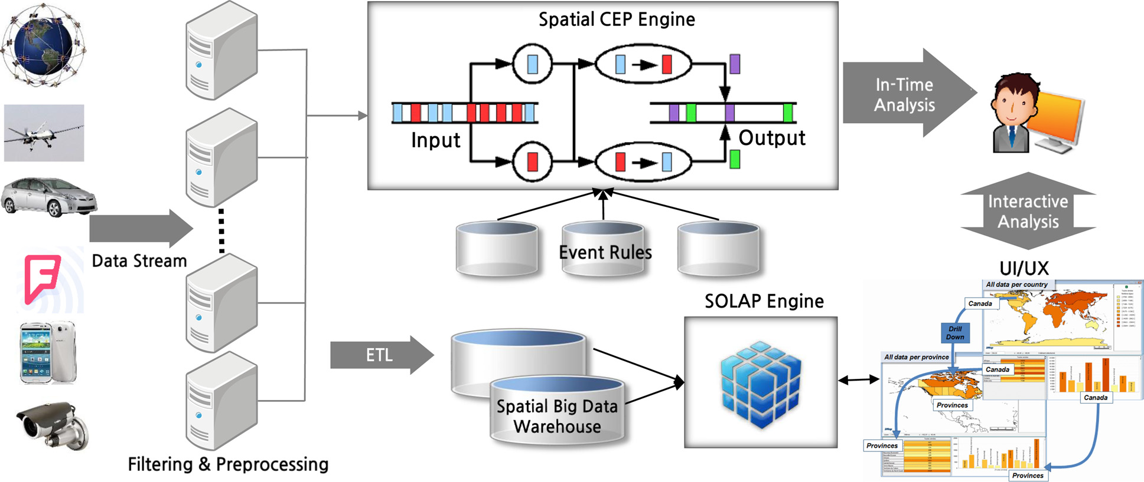
Spatial Big Data Platforms
CEP = complex event processing, SOLAP = spatial online analytical processing.
ETL = extract, transform and load, UI/UX = user interface/user experience design.
Interactive Analytics System—adopted from Lee and Kang (2015)

Slide 12
Spatial Big Data Platforms:
Other Examples
Geo-targeted Event Observation (GEO) Viewer
  For real-time situation awareness for incident commanders and decision makers during disaster events (using twitter messages) http://vision.sdsu.edu/hdma/wildfire/ (Jung, Tsou, and Issa, 2015)

Slide 13
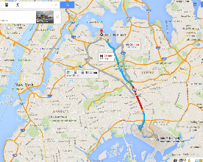
Spatial Big Data – Example of Locations and Movement of Central New York City Taxicabs, based on space, time, and attributes
A user-friendly interface TaxiVis allows users to view and analyze the patterns and movements of 500,000 taxi trips daily in central NYC. The data from NY Taxi and Limousine Commission gives pickup and drop off locations, time, and attributes.
Commercial map rendering is done using Google Maps, Bing Maps and OpenStreet Map. Simple or complex queries can be done.
Balance between simplicity and expressiveness.
The example shows taxi trips from lower Manhattan area to LaGuardia airport area (upper part of image) and Kennedy airport area (lower part). The volume of trips are given in the lower hourly graphs for Sundays in May 2011 (left) and Monday (right), with blue for LaGuardia and red for Kennedy.
(Source: Ferreira et al., 2013)

Slide 14
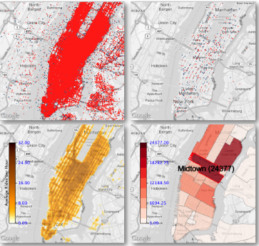
New York City Taxi example – further capabilities
Side-by-side “sensor” maps over time
Visual queries for pick-up AND drop-off
Constraints of attributes of taxi id, distance traveled, fare, and tip amount
    Enables economic analysis
Complex queries.
    Use set-theoretic functions on simple queries
Level-of-detail reduced the number of points shown on the map.
    Done by hierarchical sampling of point cloud
Density heat maps
Different visualizations
(Source: Ferreira et al., 2013)

Slide 15
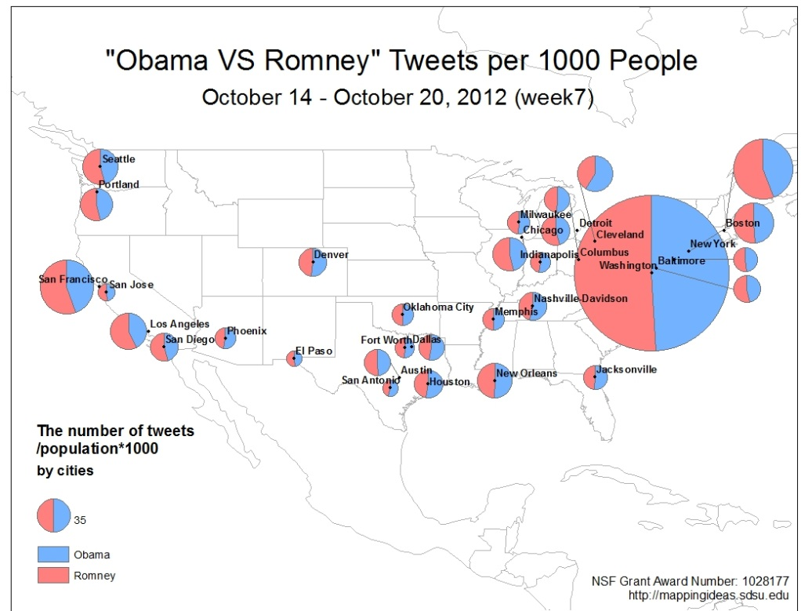
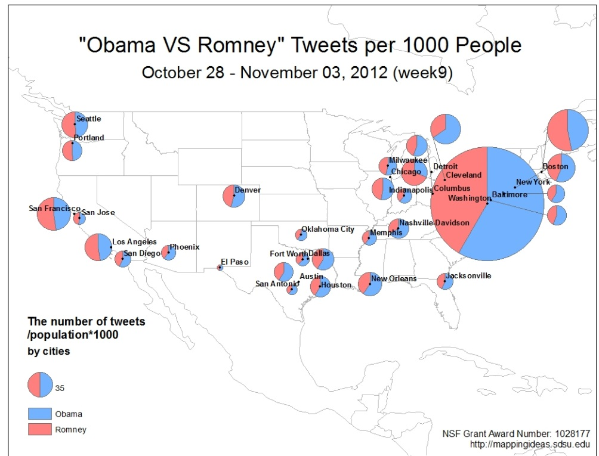
Spatial Big Data –
Example of Obama vs. Romney Tweets
Example of Spatial Big Data using social media is a live feed of number of tweets with “Obama” keyword and tweets with “Romney” keyword for largest 30 U.S. cities from Oct. 14-Nov 3, 2012.
The maps from Prof. Ming-Hsiang Tsou of San Diego State show the period before Hurricane Sandy hit East Coast (it hit on Oct. 29, and during the storm (it ended on Nov. 5).
There is a major shift towards Obama during this two week interval, which is more prominent in the northeast.
Most tweets originate with mobile devices. Errors include re-tweeting, robot tweets, city definitions, and positive or negative emotion of the tweet.
(Source: M.-H. Tsou, et al., 2013)

Slide 16
Example: Spatial Big Data for 2012 Presidential Election
Data source: millions of tweets were examined and analyzed for the same keywords.
    Techniques used were “commercial web search engines (Yahoo and Bing APIs), Twitter search engine API, IP geo-location methods, and GIS software functions of kernel density and raster-based map algebra methods” (Tsou et al., 2013).
Privacy is opt-in
    Locational referencing for Twitter is an opt-in service, so when a user decides to use Twitter, he/she is legally accepting the locational referencing option. There is no choice to disallow it.
Valence of “Obama” and “Romney” tweets was unknown
    A limitation is that whether the candidate was being referred to favorably or unfavorable was unknown. Results were interpreted as positive valence, but there is a data quality issue present.
    Although the emotion is not captured, more sophisticated natural language processing could possibly capture it.

Slide 17
Applications of Spatial Big Data and Analytics
Politics
Supply Chain Management
Public Safety
Urban Traffic
Emergency Management
Healthcare
Energy
Climate Science
Marketing/Advertising

Slide 18
Lack of Research on
Spatial Big Data and Analytics
No research on spatial big data and analytics published in major MIS journals.
Studies published in other journals are mostly conceptual.
  Few exceptions, e.g., Lee and Kang (2015), Jung, Tsou, and Issa (2015), Ferreira, Poco, Vo, Freire, and Silva (2013), and Tsou, Yang, Lusher, Han, Spitzberg, Gawron, Gupta, and An (2013)

Slide 19
Current Gaps and Limitations
Data quality (citizen science)
  Big data has very low density in value in itself
Biased
  Locations, what locations?
Lack of reproducibility (private ownership)
Small data versus big data
  Marginalization of small data studies
  What data are captured is shaped by the technology used, the context in which data are generated and the data ontology employed (Kitchin, 2013).
Need research about spatial big data as well as studies using spatial big data.

Slide 20
Current Gaps and Limitations
Evolving analytics for spatial big data
    When to analyze whole unstructured big data-set versus analyzing selective structured slices.
    New and evolving analytic techniques for spatial and non-spatial dimensions of big data.
Space-time for spatial big data and analytics
Corporate secrecy and proprietary limitations.
Corporate case studies

Slide 21
Summary: Tying together Big Data, Analytics, & GIS
A technical, algorithmic, and software base of the intersection of big data, analytics, and GIS has been set.
Since the preponderance of data is, or can be, geo-referenced, the size of spatial big data is vast.
Analytics are needed since the extent of map visualization is overwhelming.
Computer Science and GIScience are taking the lead.
The limited documented examples illustrate the power and discovery aspects.
There are lots of questions and much future work to be done.
MIS has an important role to play……….

