Slide 1

Office of International Students & Scholars (OISS) Orientation
Maintaining Status As an International Student

Slide 2

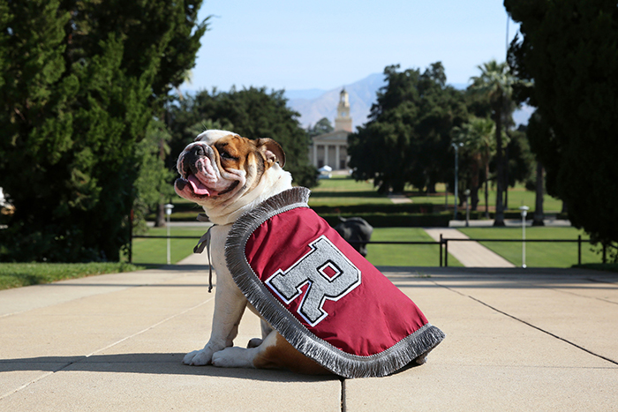
Purpose of Presentation
Introduce you to your international student services.
Provide critical information to help you maintain your legal status.
Complete your mandatory check-in procedure with SEVIS.

Slide 3
Introductions – OISS Team
Notes:
Everyone says a few words about roles and involvement

Slide 4

The Role of OISS
ADVICE: Advise on immigration and other governmental regulations.
SUPPORT: Organize orientation and continued assistance through workshops such as Employment and Income Tax.
ADVOCACY: Represent and voice your interests, needs and concerns.
When you have questions or concerns, please email us at OISS@REDLANDS.EDU.

Slide 5

How to Engage
OISS EVENTS: attend all mandatory events to stay informed
OISS OFFICE HOURS: TBA
SCHEDULE A 1:1 APPOINTMENT:
Email oiss@redlands.edu
JOIN RISA: Redlands International Student Association

Slide 6
Maintaining Records

Slide 7
OISS is here to help but, ultimately, you are responsible for maintaining your status.
    Stay update on policies here: https://studyinthestates.dhs.gov/
Please reach out any time your have concerns or questions about your status!
.

Slide 8

Maintain Your Student Status
Enroll Fulltime during the academic year at the school listed on your I-20 or DS-2019. Obtain OISS authorization before reducing your course load.
Keep your I-20 or DS-2019 valid and extend it with OISS before it expires.
Renew your Passport with your home country consulate before it expires.
Work only as authorized.
Abide by the law. Conviction of a crime that leads to UOR disciplinary action could jeopardize your status.
Depart the U.S. within your grace period.

Slide 9

SEVIS
The Student Exchange Visitor Information System (SEVIS) is a secure internet-based system, run by the U.S. Department of Homeland Security (DHS).
SEVIS allows schools to:
  Provide certain authorizations to students.
  Convey required information to the U.S. federal government.
  Parts of SEVIS information can be seen by U.S. Embassies and Consulates, the school you are attending, and other U.S. federal agencies.

Slide 10

Report Your Address
Federal regulations require you to report address changes within 10 days of moving.
Students who live off campus must report address changes to the Registrar’s & OISS:
  Current residence in U.S.
  Emergency Address is not required, but strongly recommended.
All addresses must be a physical street address. No P.O. Box addresses allowed.

Slide 11

Study Abroad & F-1 Status
Students on F-1 status can study abroad in another country for one semester or one academic year.
When studying abroad, students are required to meet the full time requirements.
You must make an appointment with OISS for advising on how to maintain your status while studying outside the U.S.

Slide 12

Reducing Your Course Load
You MUST first obtain approval from OISS before reducing your course load in order to maintain your legal status.
  OISS approvals are reported to the federal government via SEVIS.
There are very few acceptable reasons you may be authorized to enroll below fulltime.
If you attempt to drop a course or withdraw from the University of Redlands outside of normal registration windows, you will be blocked from doing so. You MUST speak to OISS to obtain a prior approval.

Slide 13



Acceptable reasons for reducing your course load:
Academic or language difficulty- Available for only one semester of the entire degree program.
Final term of study – Available when you do not need a fulltime load to complete your degree requirements.
Medical problem- You can be authorized to take a reduced load for a maximum of one year.

Slide 14
Documents

Slide 15
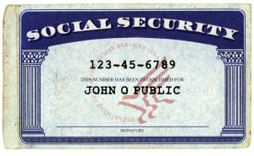
Social Security Numbers
Only students with employment are eligible to apply for a Social Security Number (SSN).
Everyone needs a letter from OISS in order to apply for an SSN.
  F-1 students:
    CPT jobs: you need to bring CPT application and job offer letter to OISS in order to request CPT authorization and obtain letter to SSA.
    On campus jobs: you need letter from department offering you the job and letter from DSO, OISS.
  J-1 students: You must obtain permission to work on campus from OISS.
  Students will be provided with a letter to take to SSN in support of their application for SSN.

Slide 16

Visa
You need a Visa to enter the U.S.
It is okay for your F-1 or J-1 visa in your passport to expire while you are in the U.S.
The visa must only be valid when crossing the border to enter into the U.S.
Since the F or J visa can expire without consequence while you are in the U.S., it is not possible to renew your visa while inside the United States.

Slide 17

Passport
Your Passport cannot expire in the U.S. Contact your home country embassy or consulate in the U.S. to renew your passport at least 6 months before it expires.

Slide 18
I-20
The Form I-20 is an important document that you should keep safe, as you will need it throughout the international student life cycle.
You will need a new I-20 any time any time your SEVIS status changes.
Requesting an I-20 extension even ONE DAY AFTER the expiration date is too late and you would no longer be in legal visa status.
CONFIRM YOUR PROGRAM END DATE

Slide 19
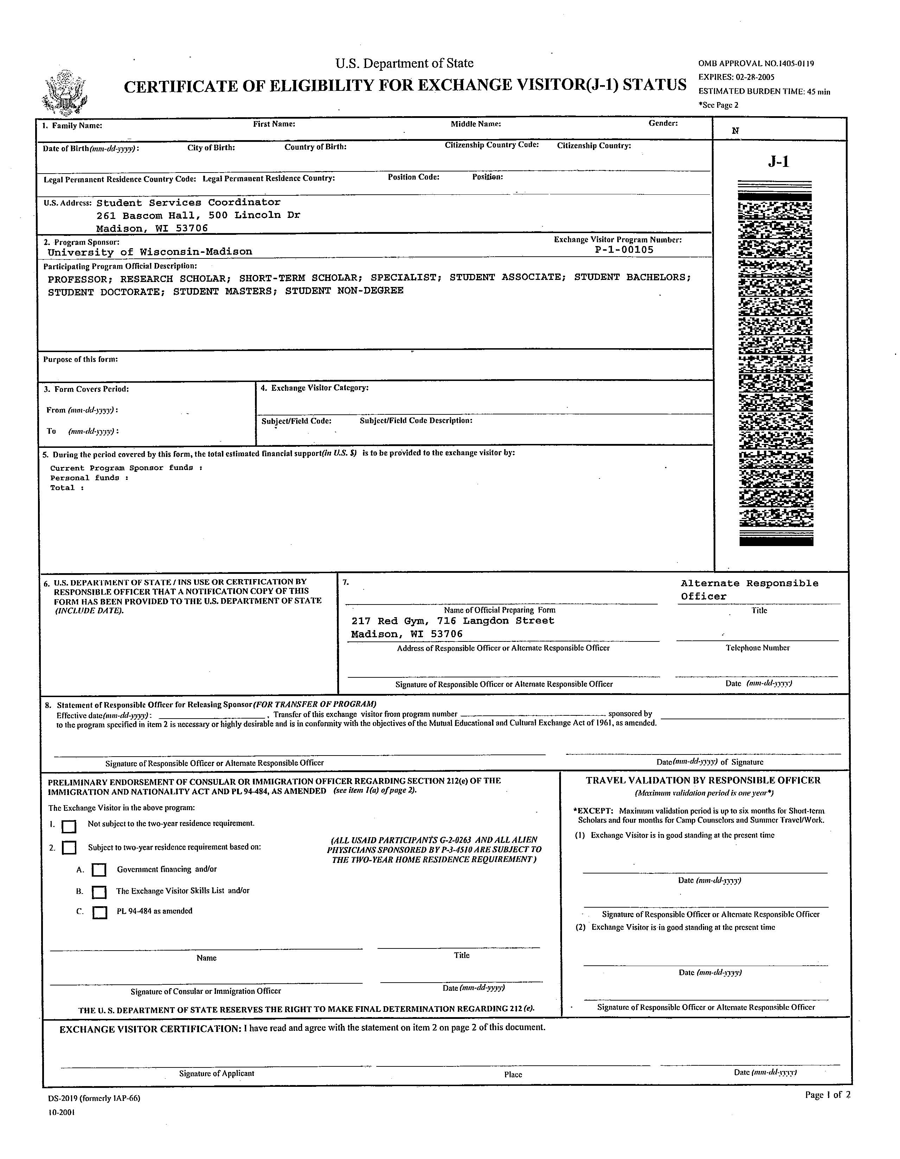
DS-2019
The Form DS-2019 identifies the exchange visitor (or J-2 dependent) and the designated sponsor and provides a brief description of the exchange visitor’s program, including the start and end date, category of exchange and an estimate of the cost of the exchange program.

Slide 20
I-94 Card (arrival/departure record)
The following information is required to retrieve your Admission (I-94) number. Enter the information as it appears on your passport :
  Family name
  First name
  Birth date(MM/DD/YYYY)
  Passport number
  Country of Issuance
  Date of Entry (stamped inside your passport, and
  Class of admission (F1 or J1).
  https://i94.cbp.dhs.gov/I94/request.html
It shows the terms of your admission, including your legal status, length of time you may stay and expected departure date.
International students who enter the country at an air or sea port of entry are issued an electronic form
Those who enter the country at a land port of entry are issued a paper Form I-94.
It is important to have a copy of your Form I-94 to prove your legal visa status in the United States.

Slide 21
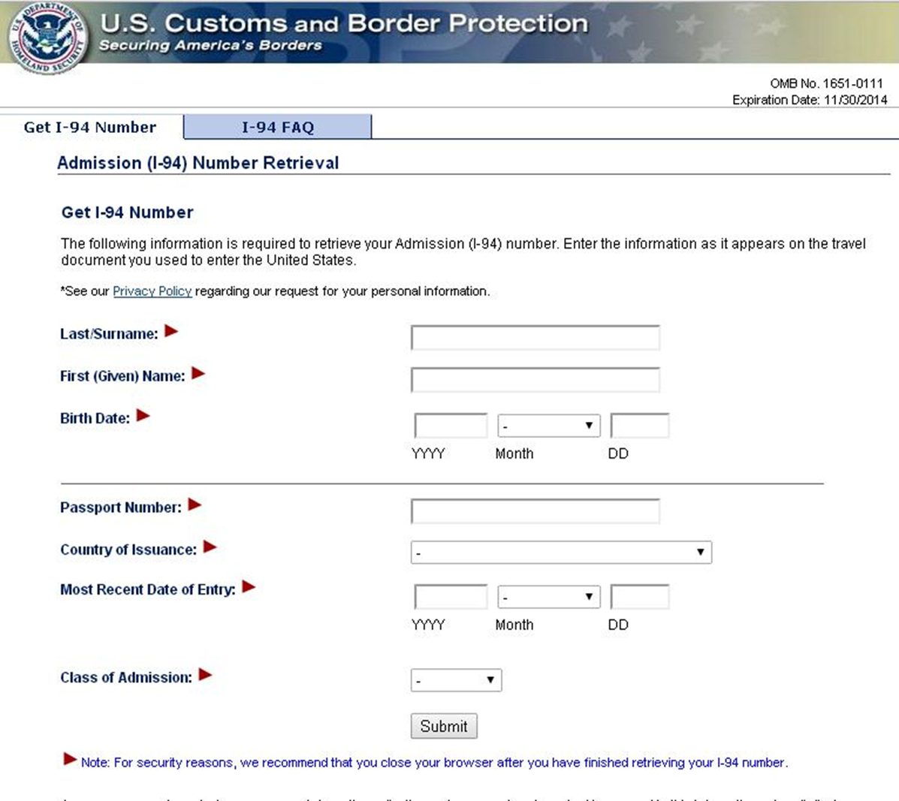
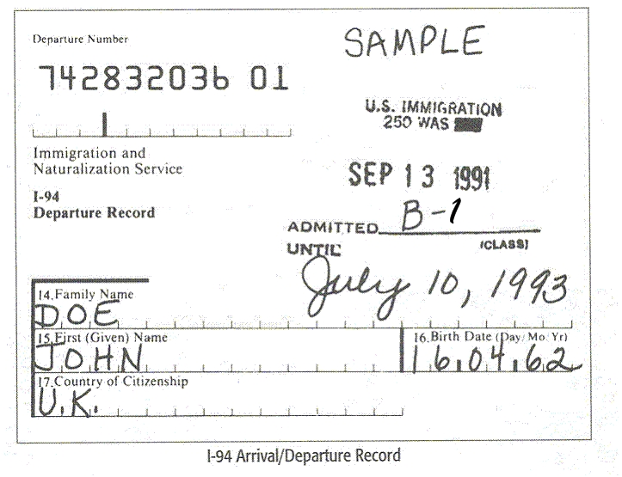
I-94 Card (land vs. air/sea)

Slide 22
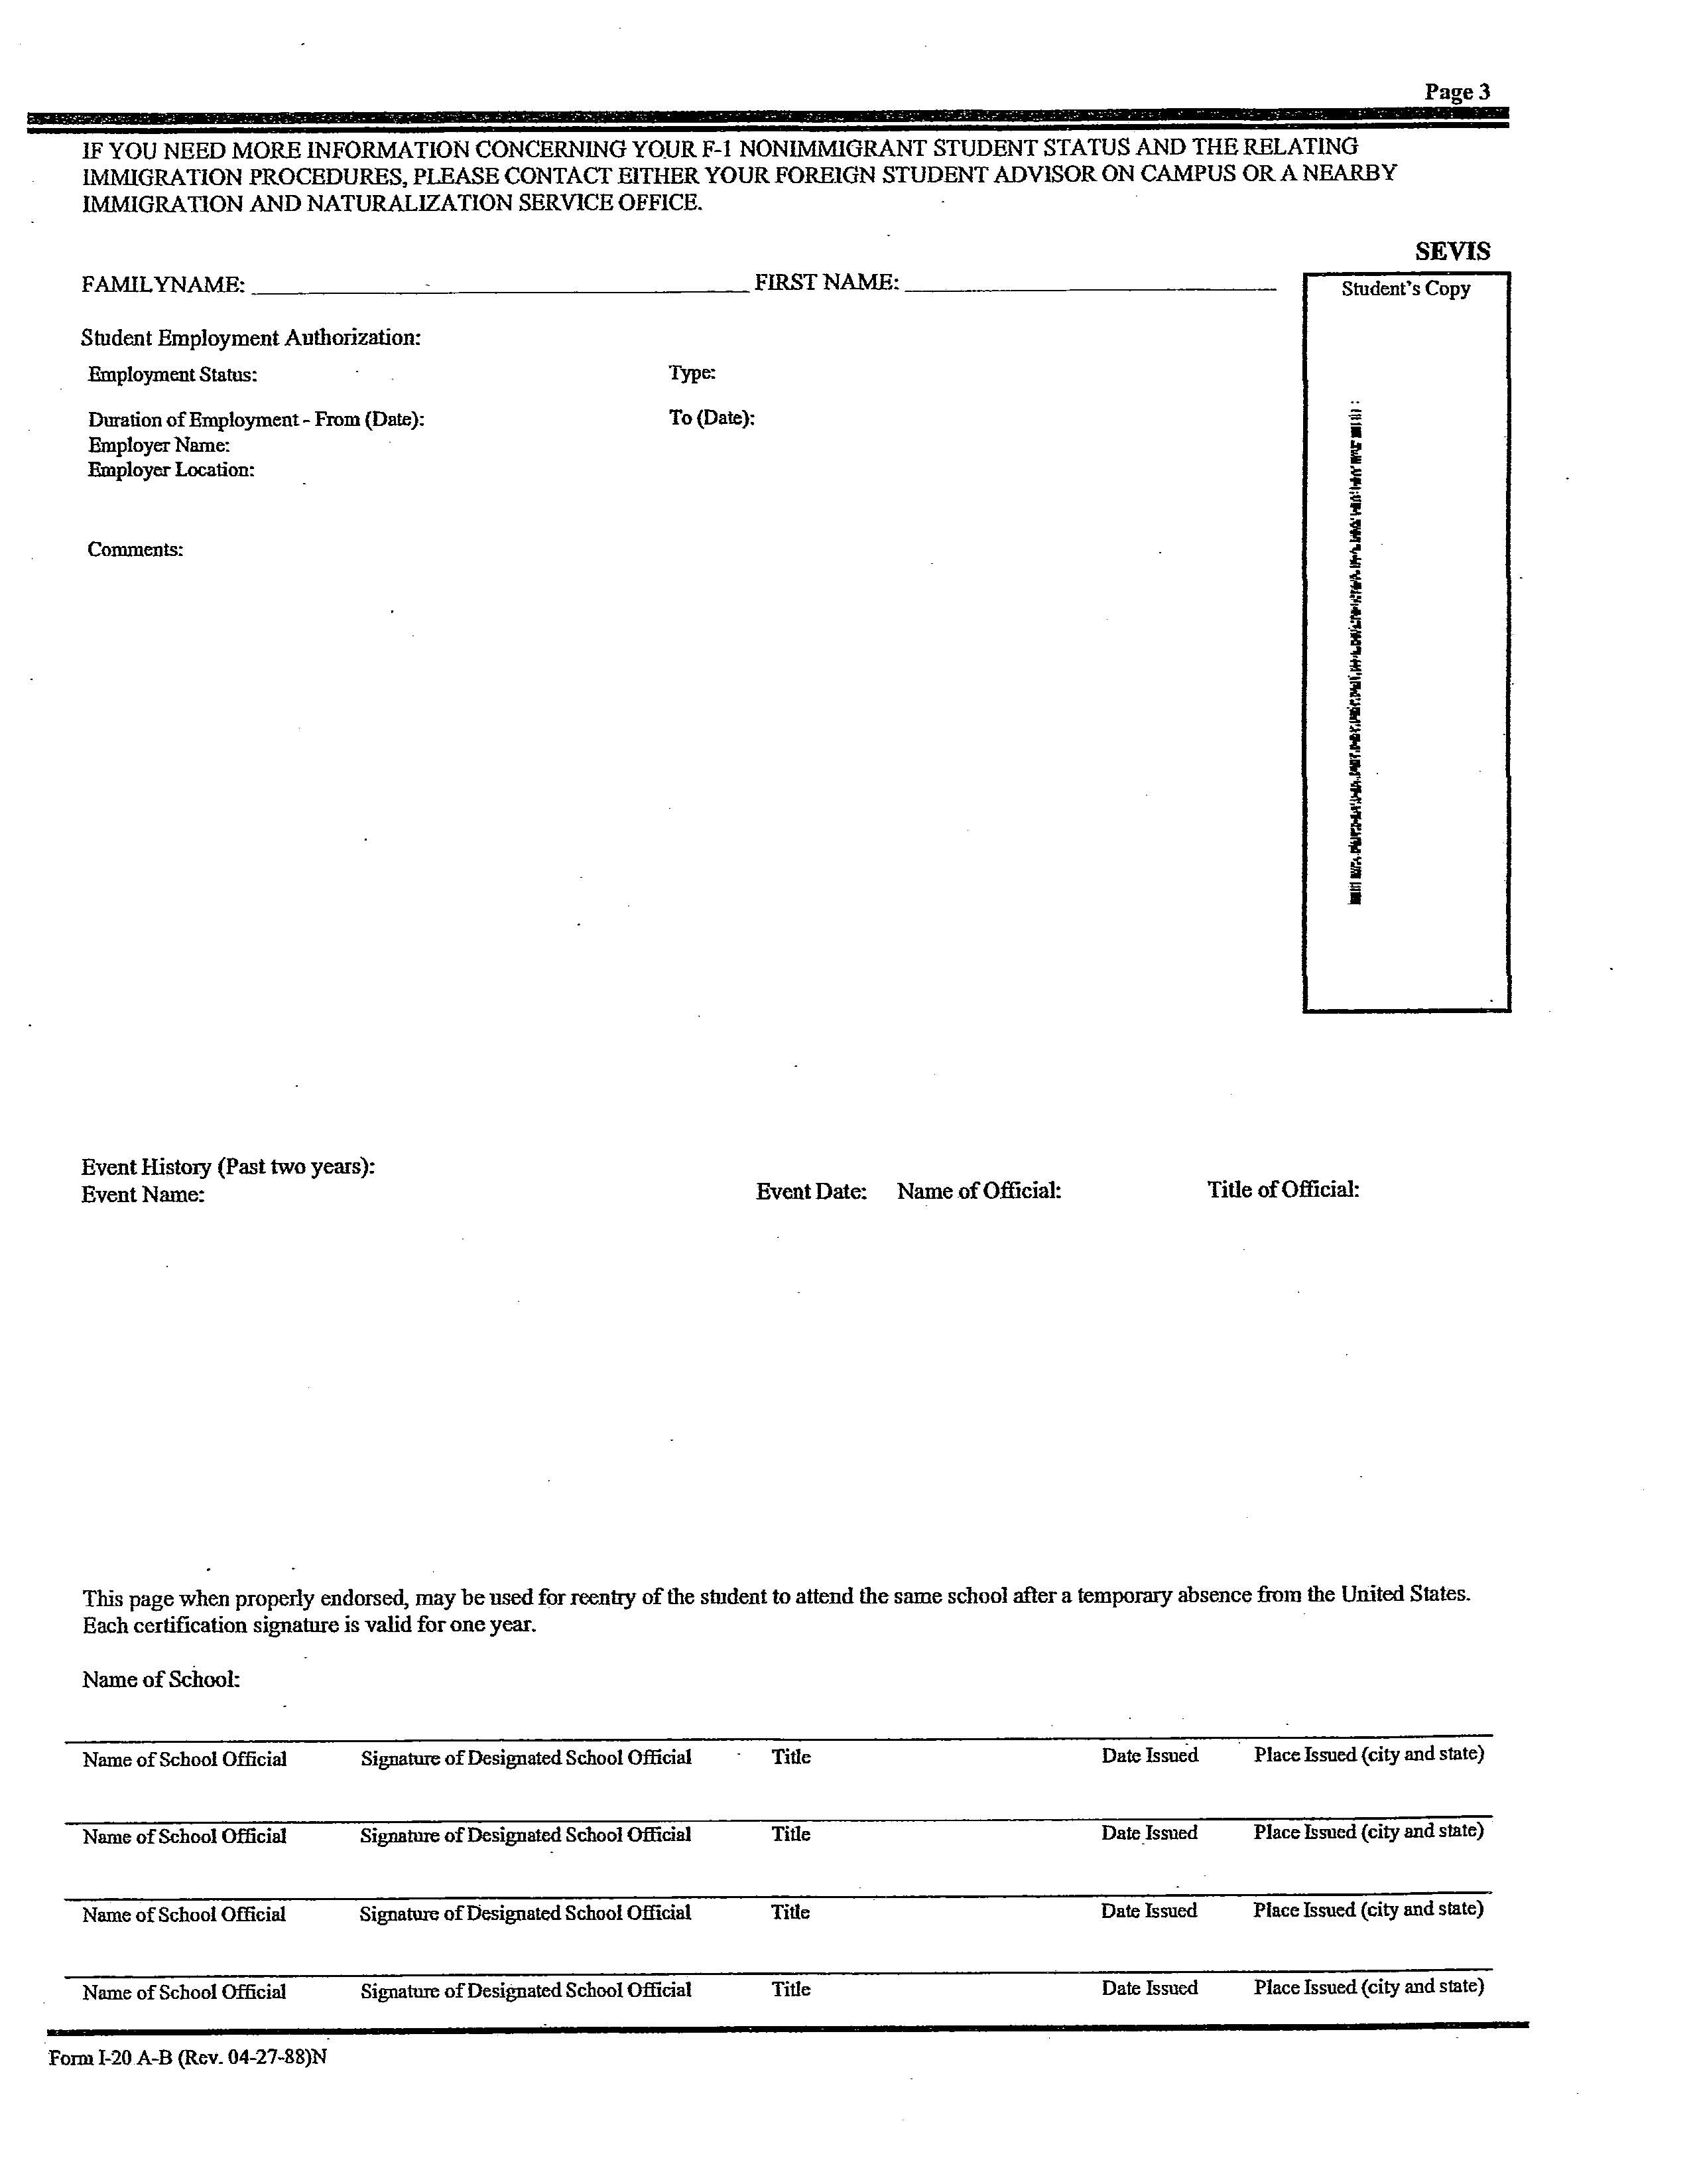
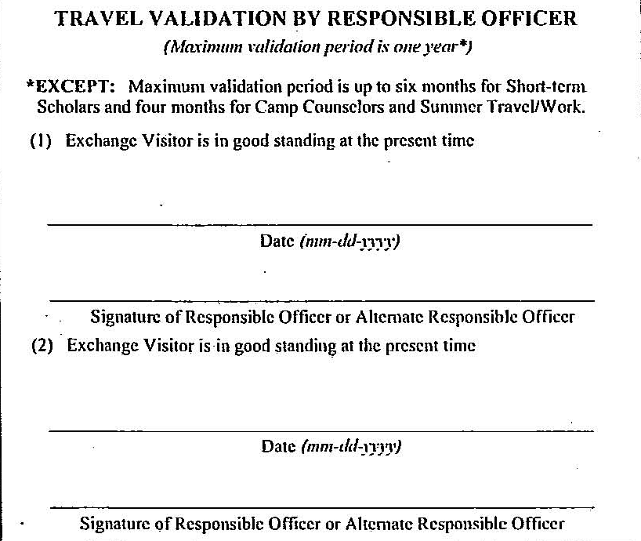
Travel Endorsement
To re-enter the U.S. you need:
Valid passport
Valid visa stamp
A travel endorsement (less than 6 months) – issued by OISS
Financial support documents
Lower right
corner of
DS-2019
Page 3 of I-20

Slide 23
Keep originals of all of your documents!
You may need to copy them for renewals or to participate in CPT/OPT

Slide 24
Employment

Slide 25
On-Campus
F-1 Status
No additional work permission is needed. You only need inform OISS you are offered a job on campus.
Includes TA
Cannot exceed over 20 hrs/wk during fall & spring semesters.
Can work over 20 hrs/week during vacation periods (winter, spring & summer breaks).
J-1 Status
Can work with written sponsor permission letter.
Cannot exceed over 20 hrs/wk during fall & spring semesters.
Can work over 20 hrs/week during vacation periods (winter, spring & summer breaks).

Slide 26

Off-Campus
An F-1 student may be authorized for off-campus
employment under the following circumstances:
• Severe, unforeseen economic necessity (after attending UoR for one year)
• Internship with an International Organization
• A student cannot begin the off-campus employment until he or she receives authorization from OISS and/USCIS.

Slide 27
Practical Training
Curricular Practical Training (CPT)
Optional Practical Training (OPT)
Position MUST be related to major(s) and approved by the academic program. Student must be in good academic standing.
  Undergraduates: Can be authorized after maintaining F-1 visa status for one academic year.
  Graduates: Are not required to meet the one year condition.
Time spent enrolled in at least one full academic year enrolled in a full course of study in other SEVIS approved schools in the United States can count towards the one academic year requirement.
Full time employment for 12 months which you can apply for (90) days before your completion date.
  Detailed PowerPoint available on the OISS Website
STEM majors are eligible for OPT Extension for additional (24) months.

Slide 28
Volunteer & Unpaid Internships
Volunteering
Unpaid Internships
Volunteering refers to donating time with an organization whose primary purpose is charitable or humanitarian in nature, without remuneration or any other type of compensation.
So for example, it would be OK to donate time with the American Red Cross.
F-1 students are free to engage in volunteer work as long as it meets the above criteria.
Volunteering should not exceed 20 hours a week during academic term time.
Unpaid internships, on the other hand, do not usually qualify as “volunteer” work.
If an internship is unpaid, it can still be authorized as a practical training experience. If you are unsure what authorization you need for an unpaid internship, your DSO can help.

Slide 29

Best Practices
Make and keep copies of all your visa status documents separate from originals:
    I-20 or DS-2019
    I-94 arrival/departure information or card
    F-1 or J-1 visa stamp
    Passport (photo & expiry pages)
Do not carry around your documents unless needed.
We advise you to apply for California ID or California Driver License. For more information contact oiss@redlands.edu.

Slide 30
Applying for OPT
You may start the OPT Extension process within (90) days prior to the completion date on your I-20. Please read about OPT policy which contains very important information to become familiar with:
https://studyinthestates.dhs.gov/sevis-help-hub/update-records/maintain-student-records/fm-student-employment/f-1-optional-practical-training .

Slide 31
To apply for OPT (Optional Practical Training):
Complete Form I-765, Application for Employment Authorization. Be sure to use the updated form, dated August 2020. At item #27 you will have to write: “( C ) ( 3 ) (B) “. This is the link for Form I-765 and instructions: http://www.uscis.gov/i-765
Write a check for the Form I-765 filing fee of $410 payable to Department of Homeland Security.
Obtain two immigration-style photos for visas and immigration benefit. (Passport pictures like)
Copy (both sides) of Form I-94 Card OR if you have travelled after April 2013 you may access and print your I-94 online: https://i94.cbp.dhs.gov/I94/#/home
Copy the ID pages of your Passport and the Visa page.
Make photocopies of all prior forms I-20 issued to you by University of Redlands.
Email a copy of Form I-765 to oiss@redlands.edu and make an appointment to check for accurate completion. Please be aware that it is your responsibility to correctly complete your OPT application. If you have questions or concerns, we suggest consulting with an immigration attorney.

Slide 32
To apply for OPT (Optional Practical Training) Continued:
8. OISS will issue a new I-20 after requesting OPT authorization in SEVIS, and will give it to you to include a photocopy with all above document to be sent to the USCIS address below if your residence address is in California. YOU HAVE 30 DAYS TO SUBMIT YOUR COMPLETED OPT APPLICATIONS TO USCIS.
9. If you move and change your address after you file your OPT application you must change your address on: https://egov.uscis.gov/crisgwi/go?action=coa.Question.HasMailChanged .

Slide 33
Applying for STEM OPT Extension
If you are applying for the STEM OPT extension, you will follow similar instructions but also use the following guidance for your training plan.
  You will submit your training plan (I-983) to OISS
Please review: https://studyinthestates.dhs.gov/assets/stem-opt-hub/story.html​ so you know how to fill out Form I-983: https://www.ice.gov/sites/default/files/documents/Document/2016/I-983.pdf
You will file a yearly performance evaluation: https://studyinthestates.dhs.gov/stem-opt-hub/additional-resources/form-i-983-overview

Slide 34
OPT – Submit & Find Work
The address for a paper application based on your residence address in California is the following:
U.S. Postal Service (USPS):
USCIS
PO Box 805373
Chicago, IL 60680
FedEx, UPS, and DHL deliveries:
USCIS
Attn: I-765 C03
131 South Dearborn - 3rd Floor
Chicago, IL 60603-5517
Finally, this is the webpage for our Office of Career and Professional Development:
  ocpd.redlands.edu
You will find useful information on online career resources, resume, and job search resources.
Examples:
  Career Shift will help you locate jobs
  Standout will help you practice interviewing

Slide 35
Additional Information

Slide 36
Grace Periods
The grace period is the additional time permitted in the visa status after completing the academic program.
F-1 students have a 60-day grace period to legally remain in the U.S. to pack, travel, apply for OPT or another academic program, or change visa status.
J-1 students have a 30-day grace period.
If you WITHDRAW from the university, with OISS permission you may be granted a 15-day grace period.
NO grace period is given for UNAUTHORIZED WITHDRAWAL

Slide 37
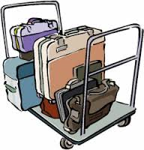
Tips For Your Travel:
Check if you need visas for the countries you are visiting, or transiting through, especially if you are not going home.
Get your I20 or DS-2019 endorsed by DSO before your departure
Check the expiration date of your visa. If you do need a new one, allow sufficient time to obtain it.
  Visa applications can take a month or longer due to security and background checks.
Expect travel delays and check emergent situations, such as Covid19, and immigration regulations

Slide 38

Dependents
F-2 and J-2 dependents are the spouse and children (under 21 years of age) of the F-1 and J-1 student.
F-2 and J-2 dependents are required to report changes in U.S. and foreign addresses within 10 days of moving by informing OISS.

Slide 39

Dependents
F-2
J-2
F-2 Study Eligibility:
F-2 spouses may not
engage in full-time or degree-related study
F-2 children may study at the elementary and secondary school levels (no college prep courses)
F-2 Work Eligibility:
F-2 dependents are not permitted to work at all
J-2 Study Eligibility:
J-2 spouses are allowed to study
J-2 children may study at any level until they reach 21 years of age
J-2 Work Eligibility:
J-2 spouses may apply through the USCIS to obtain temporary work authorization

Slide 40
Transfer Out Regulations
Students must attend classes and maintain status until the transfer release date.
Students must provide confirmation that the student has been accepted by the transfer-in school
If a student completes a course of study (or OPT), the student is eligible for transfer through the end of the 60-day grace period.

Slide 41


For More F & J Visa Information
For Immigration Regulations:
  Office of International Students and Scholars
  Email: oiss@redlands.edu
  Phone: 909.748.8716
Visit the Office of International Student & Scholars
  https://www.redlands.edu/oiss/
Government websites:
  www.uscis.gov
  http://studyinthestates.dhs.gov/students
Keep yourself informed by checking these websites often!

Slide 42

Welcome to the
U of R!
We hope you have a Successful
Academic Year!
Notes:
NOTES:
Questions? (Don’t go in depth, refer to topical session of orientation if applicable.)
THANK YOU!

