Slide 1

West Marine’s Transition to a Waterlife Outfitter: The Role of Location Intelligence
Dr. Lawrence Joseph
Research Manager
GIS Day – November 18, 2015 – University of Redlands

Slide 2
Background
My experience
Original motivation
  Need to find PetSmart locations
Line of research
  More than 50 US retailers
  Nearly 71,000 retail stores
Application to West Marine

Slide 3
Structure of Retailing
Retailers have a value platform
  Includes factors such as personnel, service, and display of goods, as well as the situational aspects of store location
Retail is dynamic
Increasing consumer differentiation
Need to satisfy investors with growth
Development of store types
Exogenous factors

Slide 4
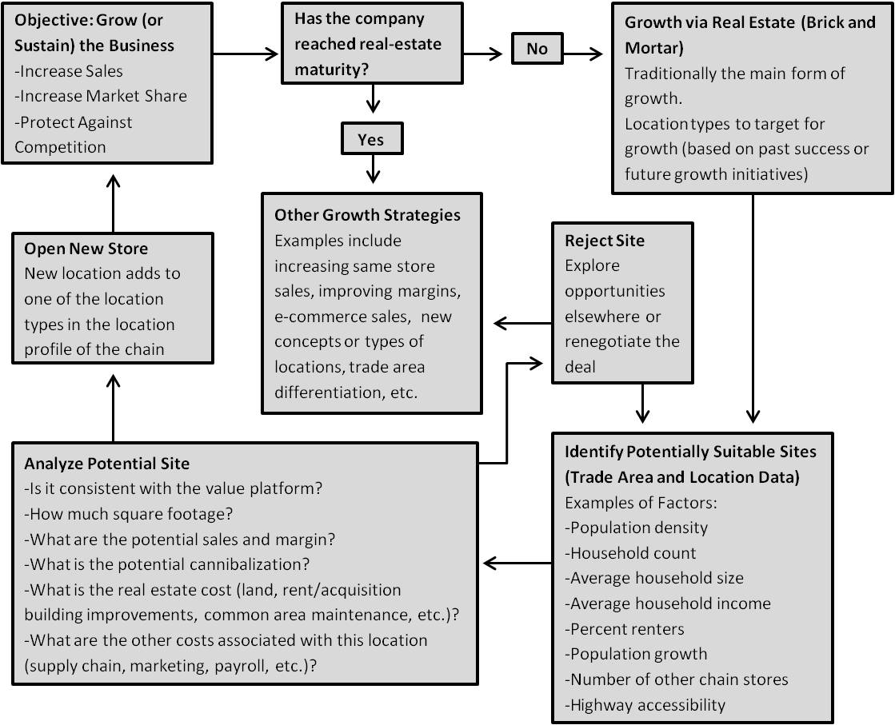
Store Deployment Process

Slide 5
Evolution of Chain Networks
Collection of individual decisions creates a chain network
Each individual deployment decision affects the chain
Empirical research has led to theories on the spatial organization of stores (and markets)

Slide 6
Real-Estate Maturity
All retailers have some point of real-estate maturity
Only a limited number of locations that can be profitable for a particular type of store
At some point, new stores increasingly cannibalize existing stores
Constraints on organic and familiar growth through new store deployment

Slide 7
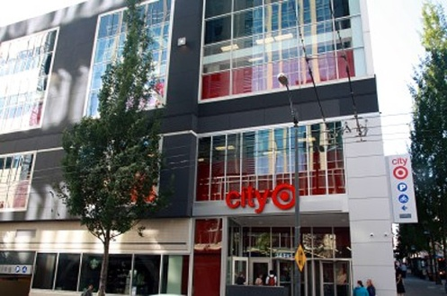
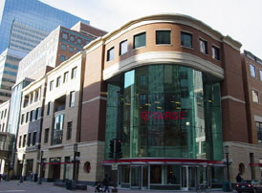
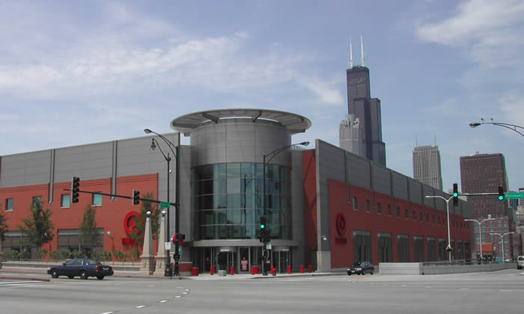

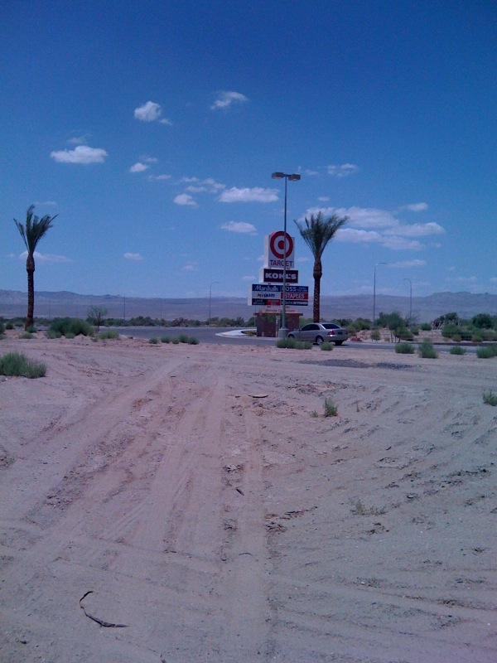
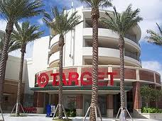
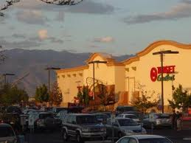
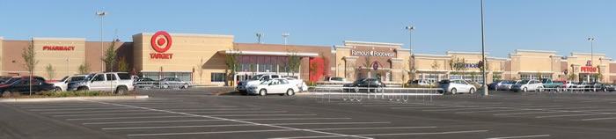
Variations in Retail Stores

Slide 8
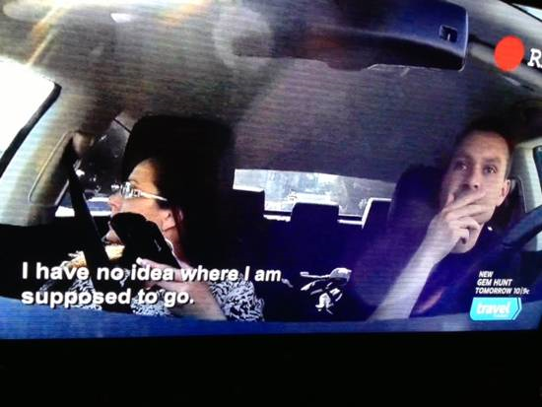
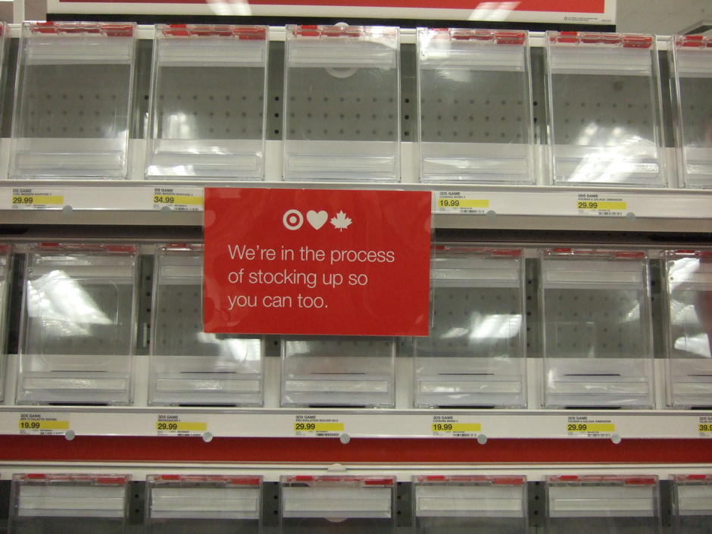

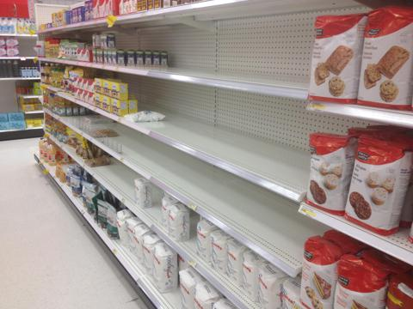
Target
CEO fired
Target takes $5.4 billion hit
Opts to leave market

Slide 9
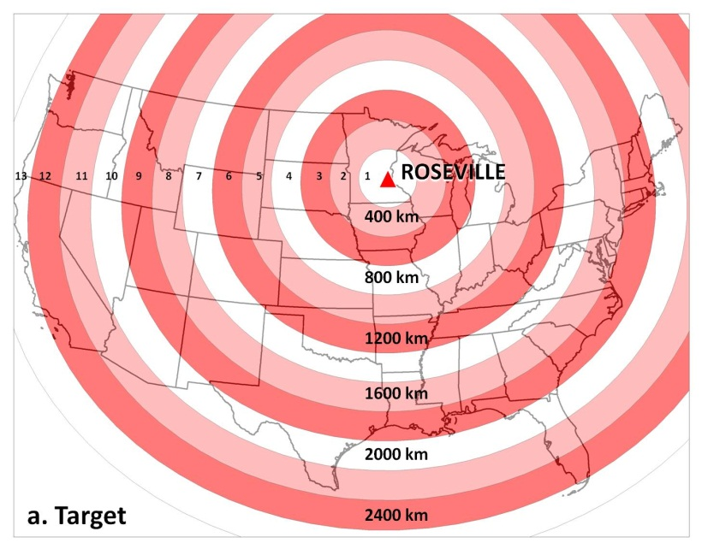
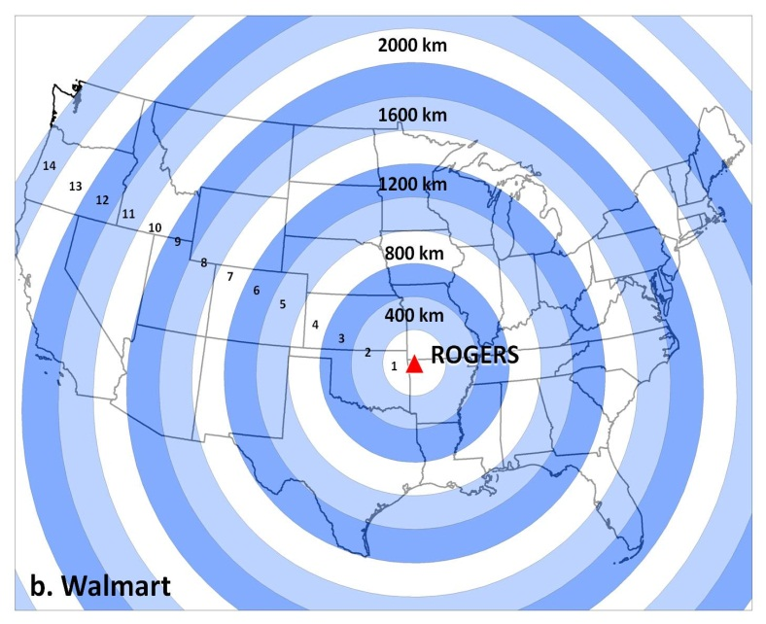
Modeling Retail Chain Expansion and Maturity through Wave Analysis: Theory and Application to Walmart and Target

Slide 10
Objectives
Introduce a method from medical geography used to study epidemiological waves
Adapt method to the study of the diffusion patterns of retail stores over time and space
Apply these modified methods to study the spread of Walmart and Target

Slide 11
Method Adapted from Cliff and Haggett (2006)
Coastal Geomorphology | Epidemiological (Cliff and Haggett 2006) | Retail (Proposed here)
 | Susceptible (S) No cases yet | Prospective No stores yet
Swash Wave moving up beach | Infected (I) Cases reported | Deploying New store growth
Backwash Wave moving back to sea | Recovered (R) No more new cases | Saturation Fewer new stores than previous period
 |  | Cannibalization (Re-swash) More new stores than previous period

Slide 12
Equations

Slide 13
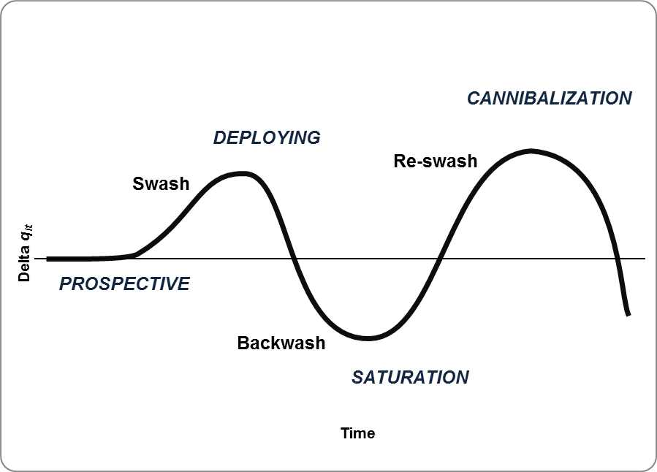
Idealized Plot of a Swash-Backwash Wave

Slide 14
Deployment Patterns of Walmart

Slide 15
Deployment Patterns of Target

Slide 16
Summary of Deployment

Slide 17
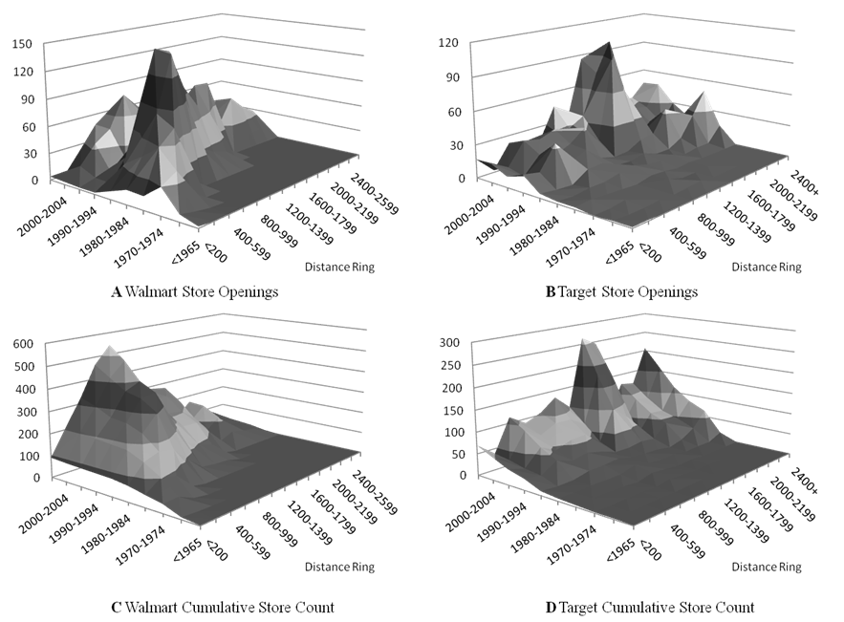
Space-Time Deployment

Slide 18
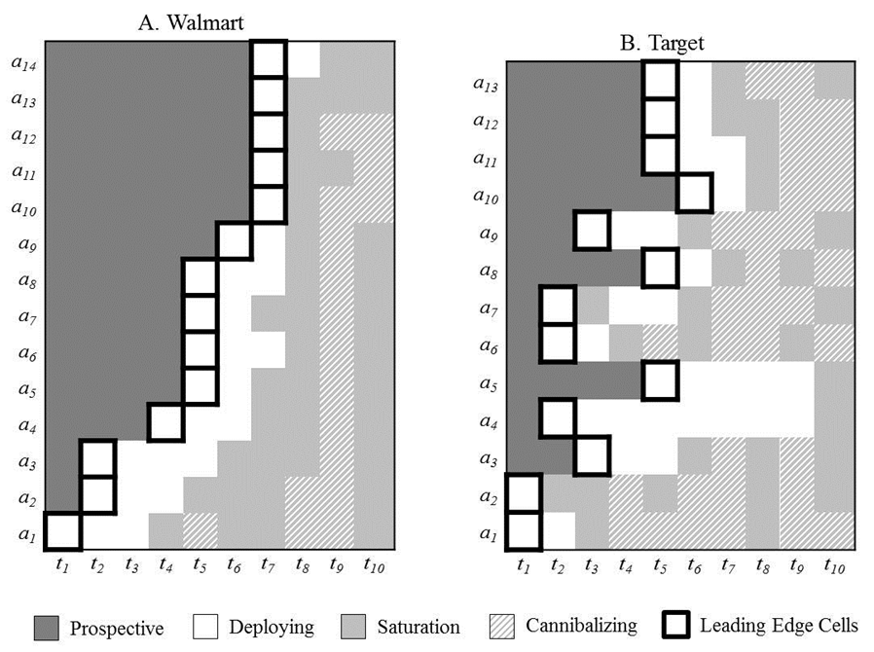

Slide 19
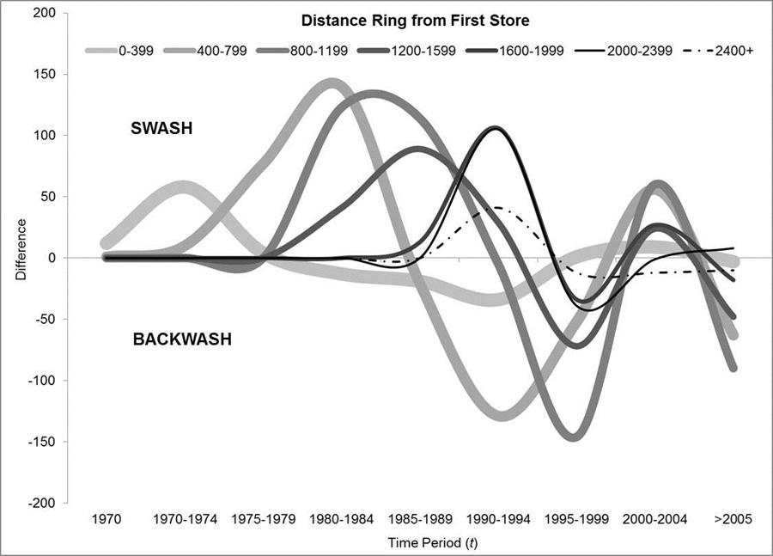
Swash, Backwash, and Re-swash Waves for Walmart

Slide 20
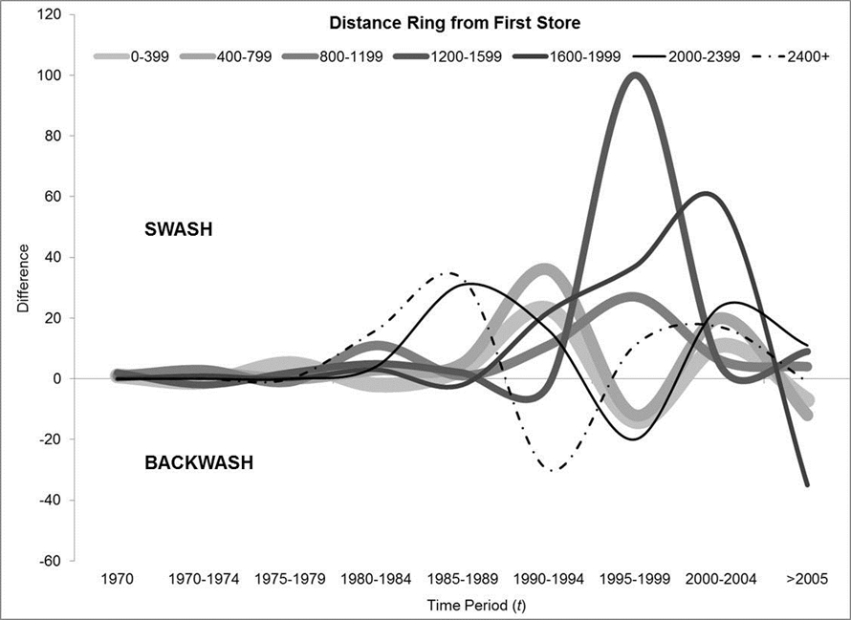
Swash, Backwash, and Re-swash Waves for Target

Slide 21
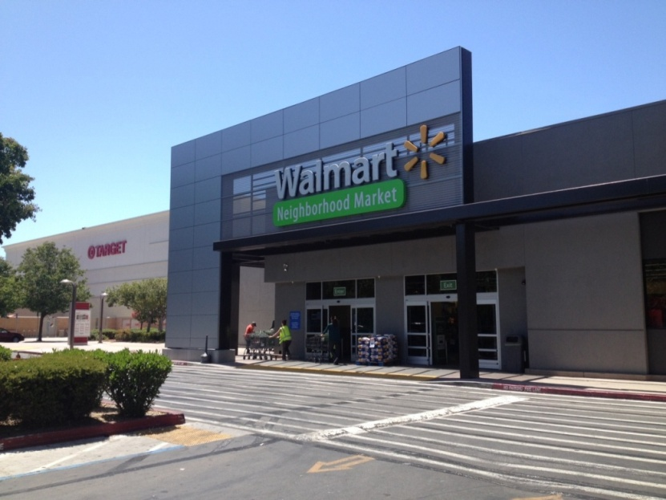
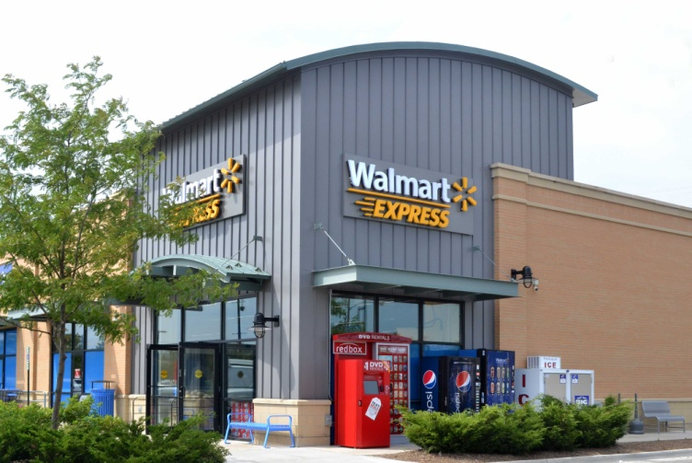
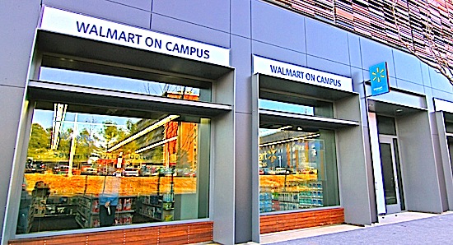
Walmart

Slide 22
Walmart Drive-time Trade Area Data
 |  |  | In 10 Minute Drive-Time Trade Areas
Type | Store Count | Standard Distance (mi) | House-holds | House-hold Size | Median Household Income | Pop Density | Average # of Grocery Stores | Average # of Walmart Stores | Average # of Neighborhood Markets
Walmart (in 1998) | 2,324 | 381.4 | 23,429 | 2.50 | $43,890 | 1,059 | 30.6 | 0.05
Walmart (in 2014) | 3,759 | 394.1 | 27,410 | 2.52 | $46,856 | 1,330 | 35.5 | 0.39 | 0.17
Walmart Neighborhood Market | 365 | 407.8 | 66,297 | 2.62 | $52,287 | 3,272 | 80.7 | 1.81 | 0.67

Slide 23
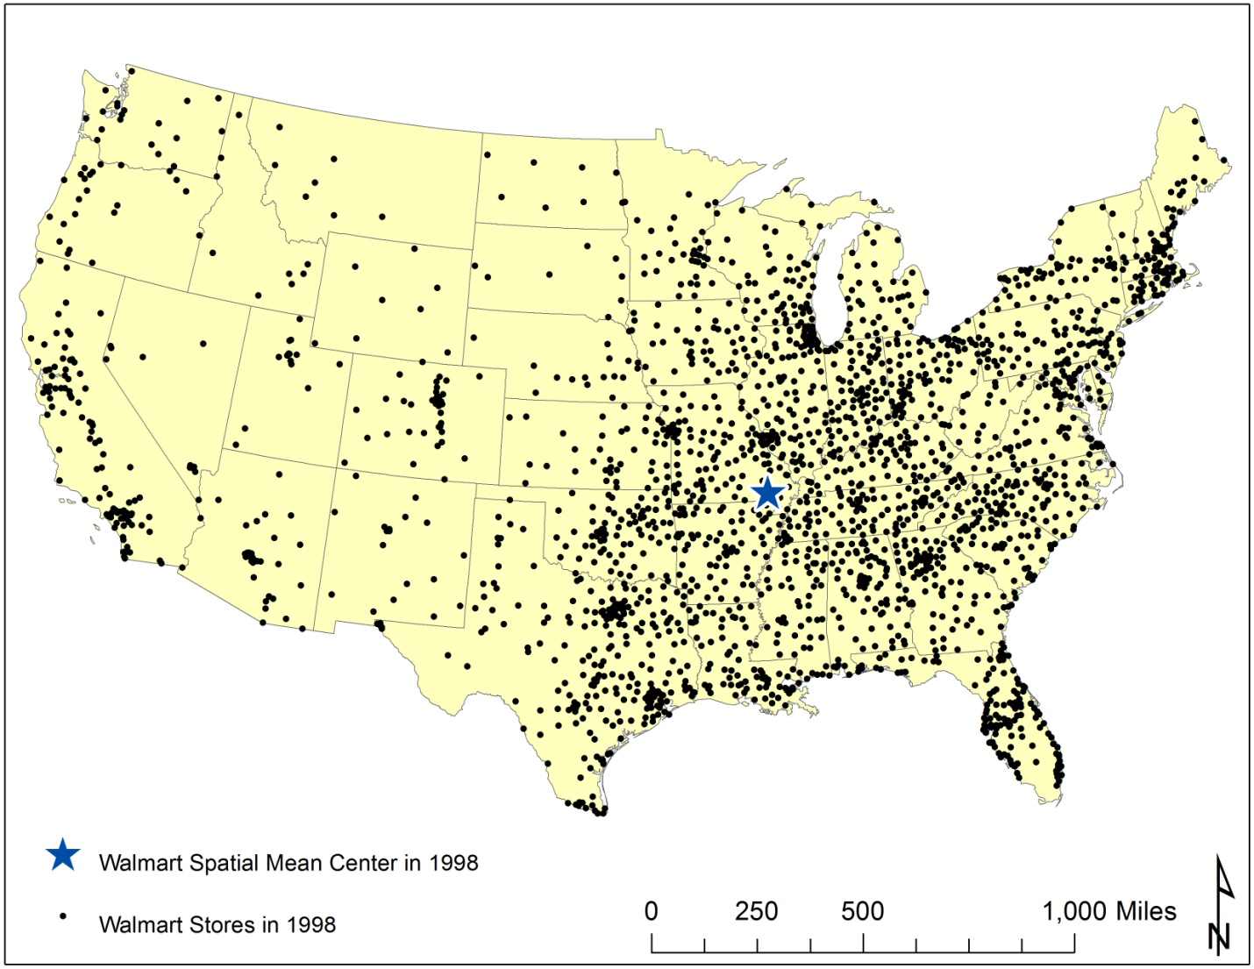
Walmart in 1998

Slide 24
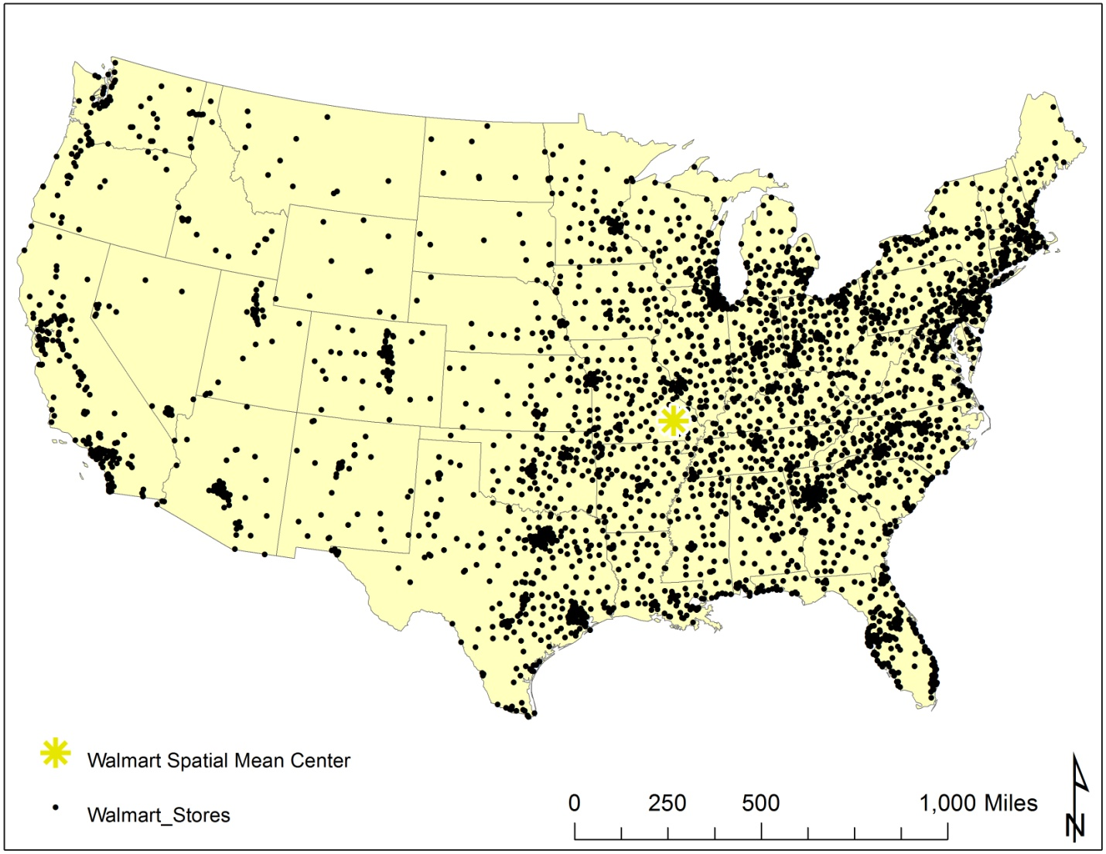
Walmart in 2014

Slide 25
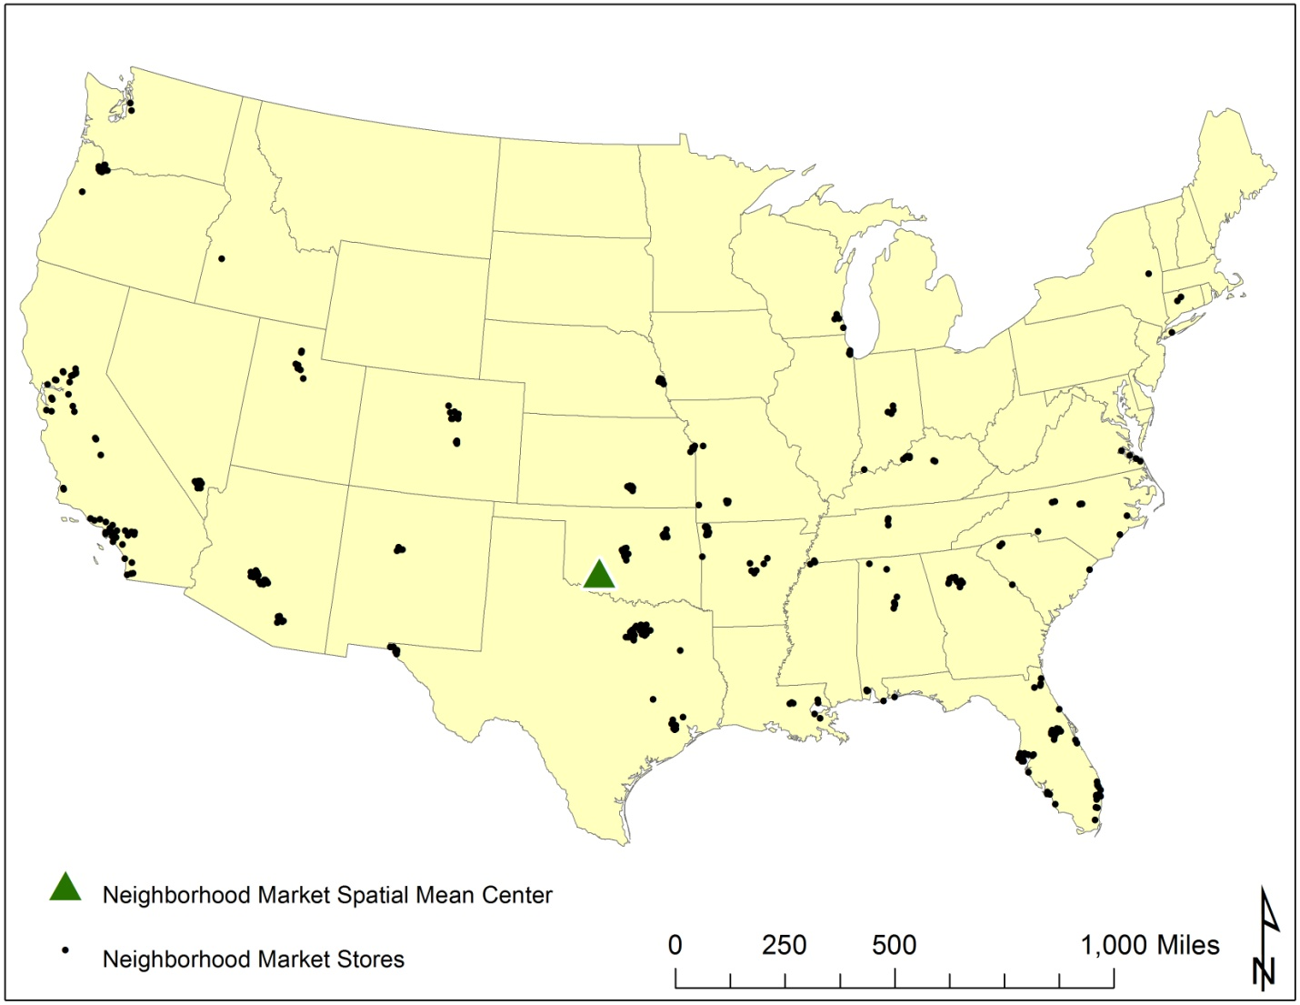
Walmart Neighborhood Market

Slide 26
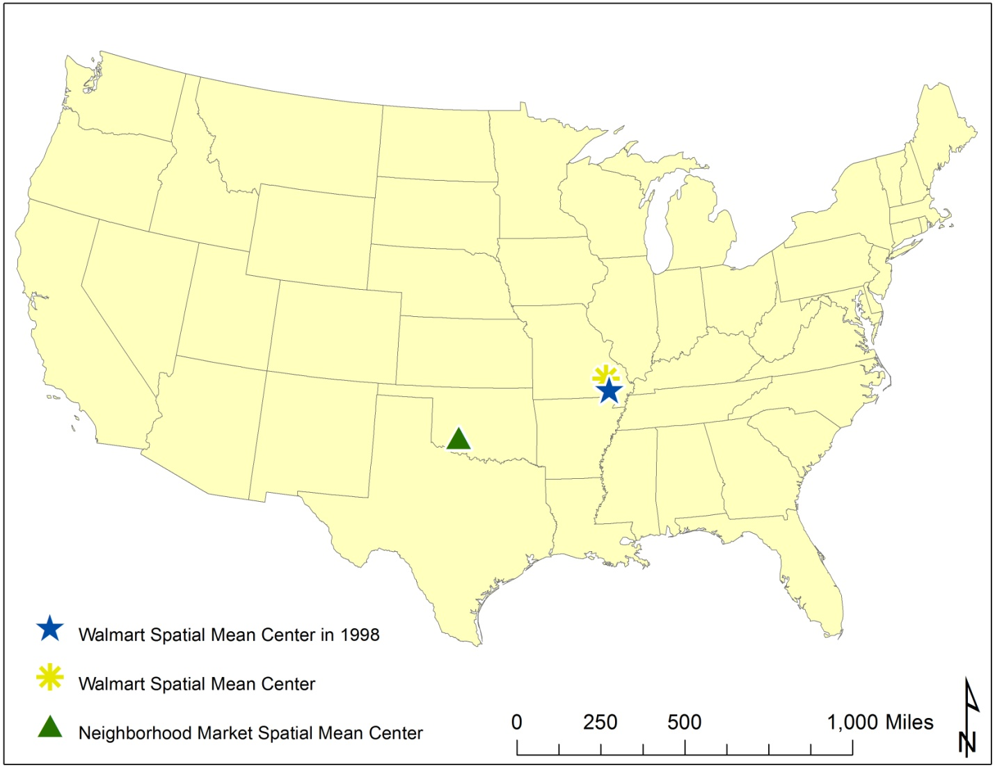
Spatial Mean Centers

Slide 27


Slide 28

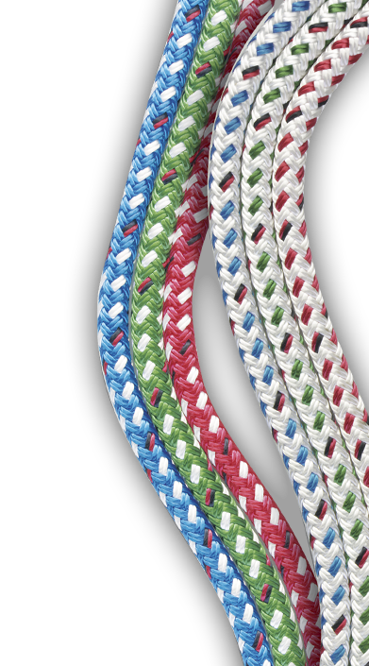
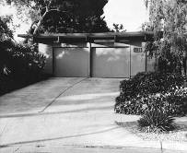
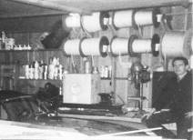
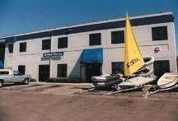
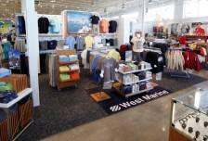

West Marine
47 Years of History
1968 - “West Coast Ropes”
in founder’s garage
1975 - First store in Palo Alto, CA
1993 - Company goes public
1996 - Acquired E&B Marine
store count to 152 doors
2003 - Acquired 63 Boat U.S. stores
Today - Expanding the business
as a Omni-Channel, Waterlife Outfitter

Slide 29
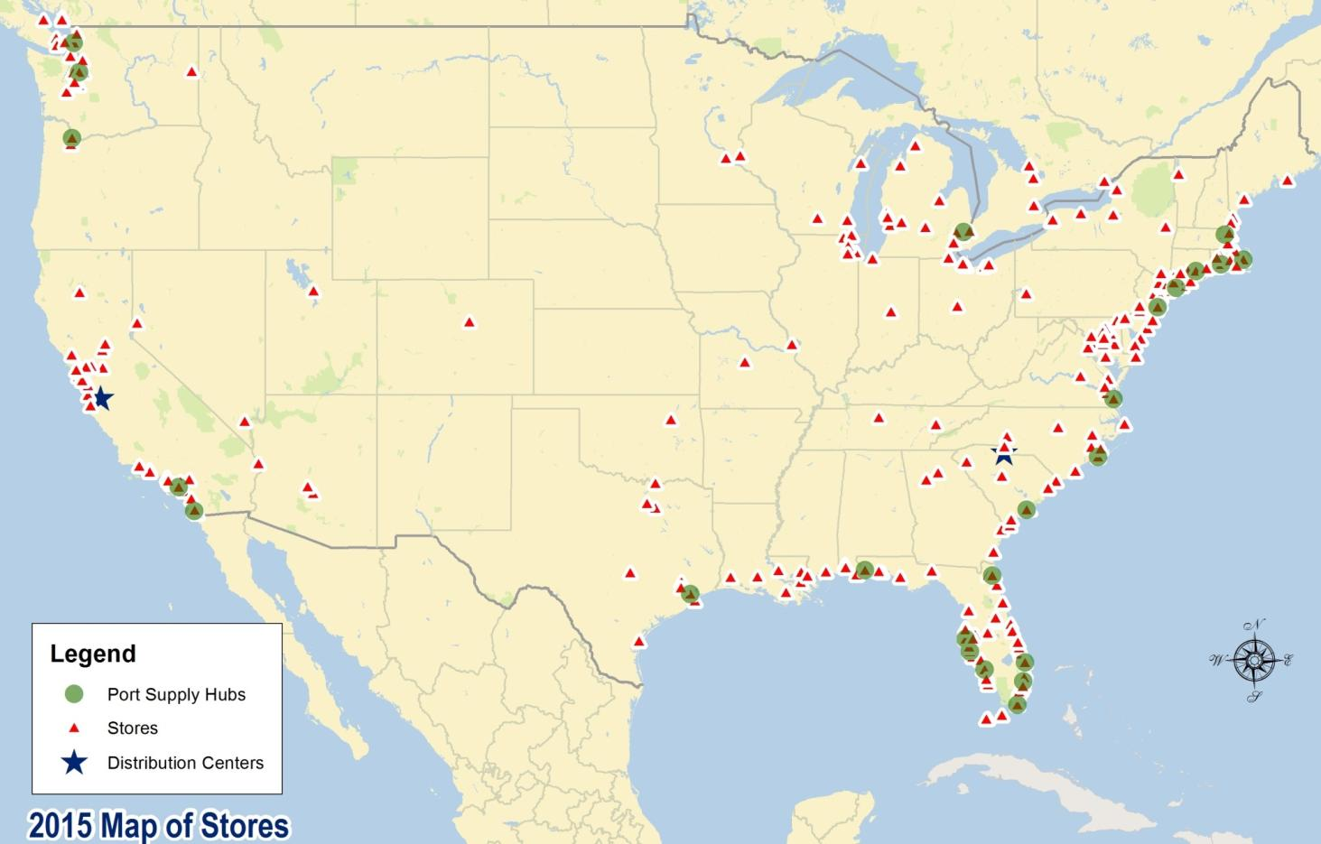

265 Stores including Hawaii, Alaska and Puerto Rico

Slide 30
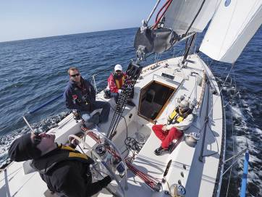
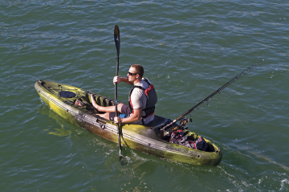
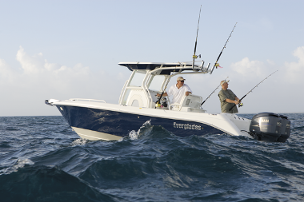


Customers
People who recreate on or around the water
  Boating participants
  Coastal lifestyle
  Outdoor activity enthusiasts

Slide 31
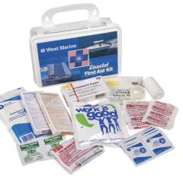
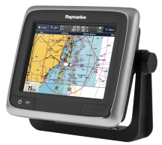
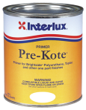
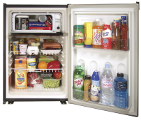
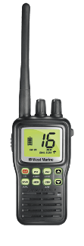

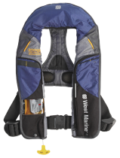
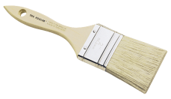
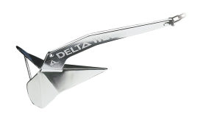
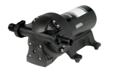
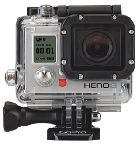

Core Products
Electronics
Safety
Maintenance
Hardware

Slide 32


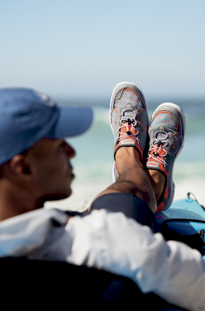

Waterlife
Apparel
Water sports
Footwear
Fishing

Slide 33
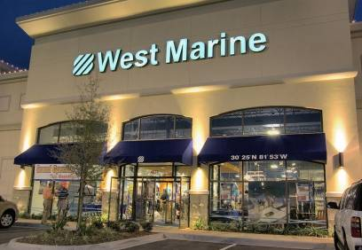
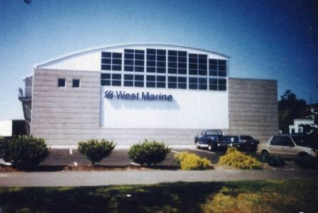
Small Store
Flagship

Slide 34
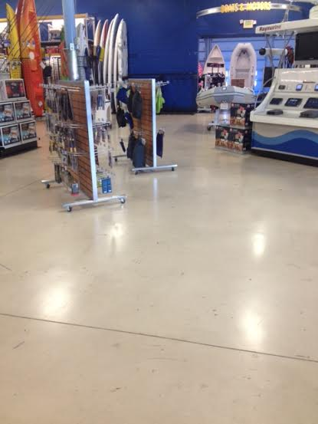
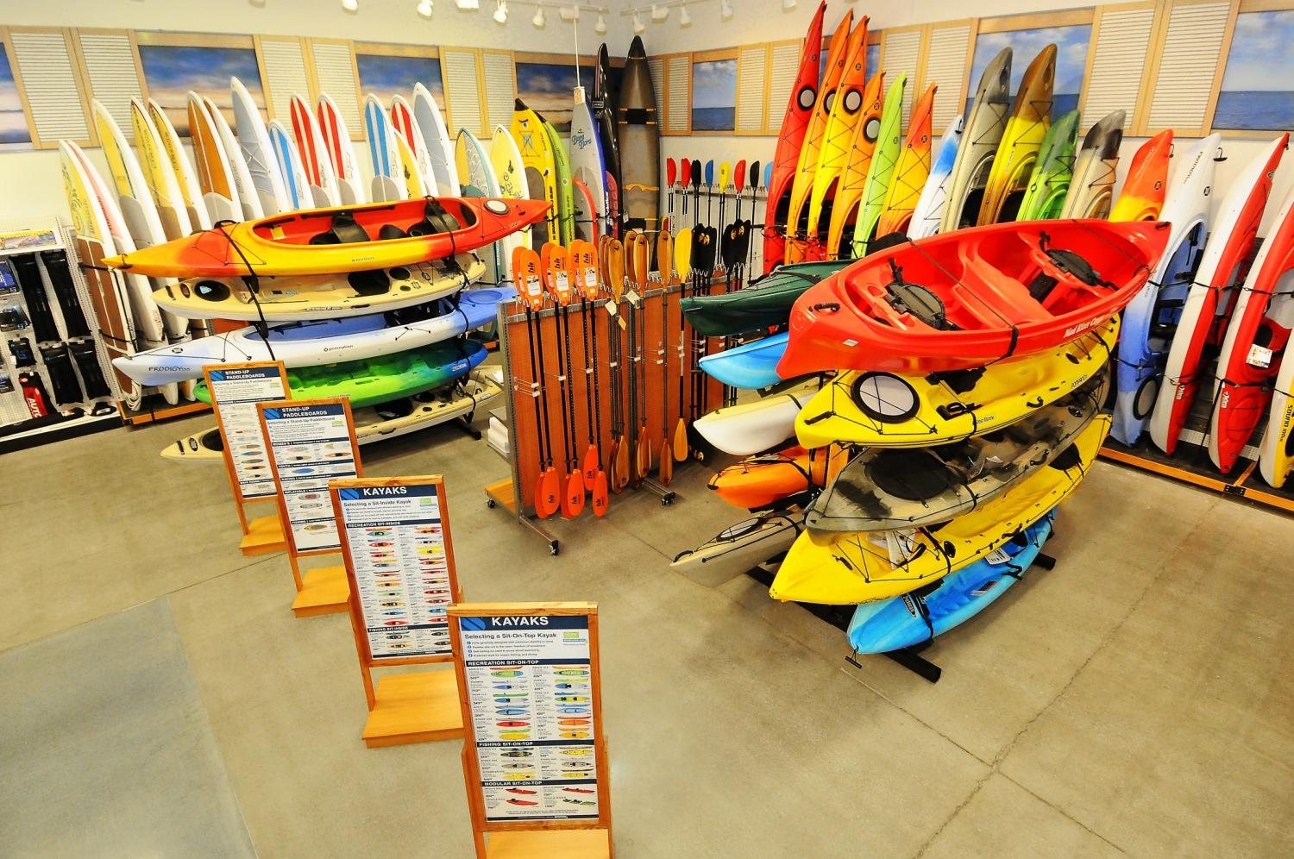
Old
New

Slide 35
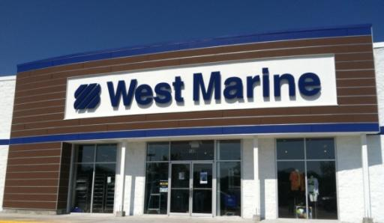


Chicago – May 2015

Slide 36





Slide 37


Core Departments

Slide 38

Chicago, IL

Slide 39


ESRI Business Analyst
Data
  Over 1,600 data variables
  Demographics
  Tapestry (Lifestyle Segmentation)
  Consumer spending
  Market potential
  Shopping center/businesses
  Competitors
  Street data
    Drive-time analysis
Customer Profiling
  Prospecting
    Admirals
    Captains
    Adventurers
Sales Forecasting
  Modeling
  Analogs
  Cannibalization

Slide 40





Distance Decay Analysis
West Marine’s leading Tapestry segment
Lifestyle affects distance decay and varies by product

Slide 41






Targeted Growth Segments
Growth segments have greater friction of distance…why?

Slide 42


Market Modeling

Slide 43

Contact: LawrenceJ@westmarine.com

